Slide 1

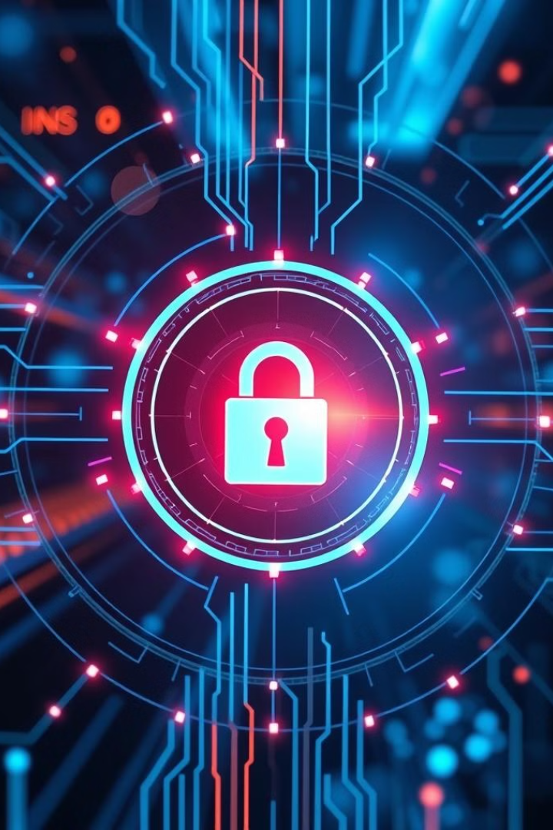


Phish Net X - Email And Website Detection
PhishNet X is a cutting-edge cybersecurity solution. It delivers a multi-layered approach to digital threat protection. Empowering organizations against sophisticated phishing attacks, it is the new standard in threat detection.
Notes:
1

Slide 2
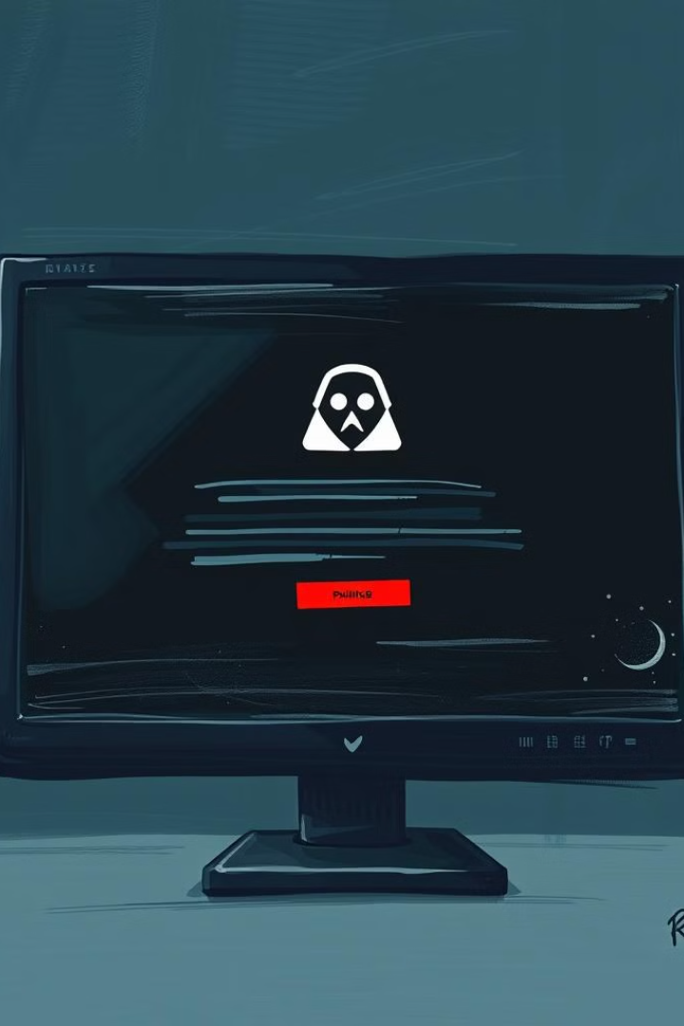



The Phishing Threat Landscape
Phishing is a significant threat. 3.4 billion phishing emails are sent daily. 83% of organizations experienced attacks in 2023. Breaches cost an average of $4.65 million. Intelligent, adaptive systems are needed.
3.4B Emails
83% Impacted
Phishing emails sent daily.
Organizations attacked in 2023.
$4.65M Cost
Average cost per breach.
Notes:
2

Slide 3

PhishNet X: Core Value Proposition
PhishNet X offers real-time threat detection. Advanced machine learning is used. Comprehensive threat intelligence is integrated. Users benefit from a seamless experience. Proactive security is now a reality.
Real-time Detection
Cross Verifying
Seamless Experience
Immediate identification of threats.
Use of API for accuracy such as Virustotal , Whois , Geoip2
Minimal false positives.
Notes:
3

Slide 4



Architectural Overview
The design is modular with four detection layers. Options include cloud-based or on-premise deployment. The architecture scales for all enterprise sizes. A microservices-based infrastructure assures 99.99% uptime.
Modular Design
Four detection layers.
Deployment Options
Cloud or on-premise.
Scalable
Supports all enterprise sizes.
Notes:
4

Slide 5




Detection Engine Components
The engine uses machine learning classifiers. Threat intelligence is integrated. Behavior analysis occurs in real-time. URLs and domains are scanned constantly. Learning and adaptation never stops.
ML Classifier
Threat Intel
1
2
4
3
URL Scanning
Behavior Analysis
Notes:
5

Slide 6
User Interface Design
The UI uses Tkinter and ttk widgets. The design is responsive across devices. Threats are visualized in real-time. The dashboard is customizable. Reporting and mitigation are instant.
Intuitive
1
Easy to use.
Responsive
2
Works on all devices.
Customizable
3
Personalized dashboards.
Notes:
6

Slide 7
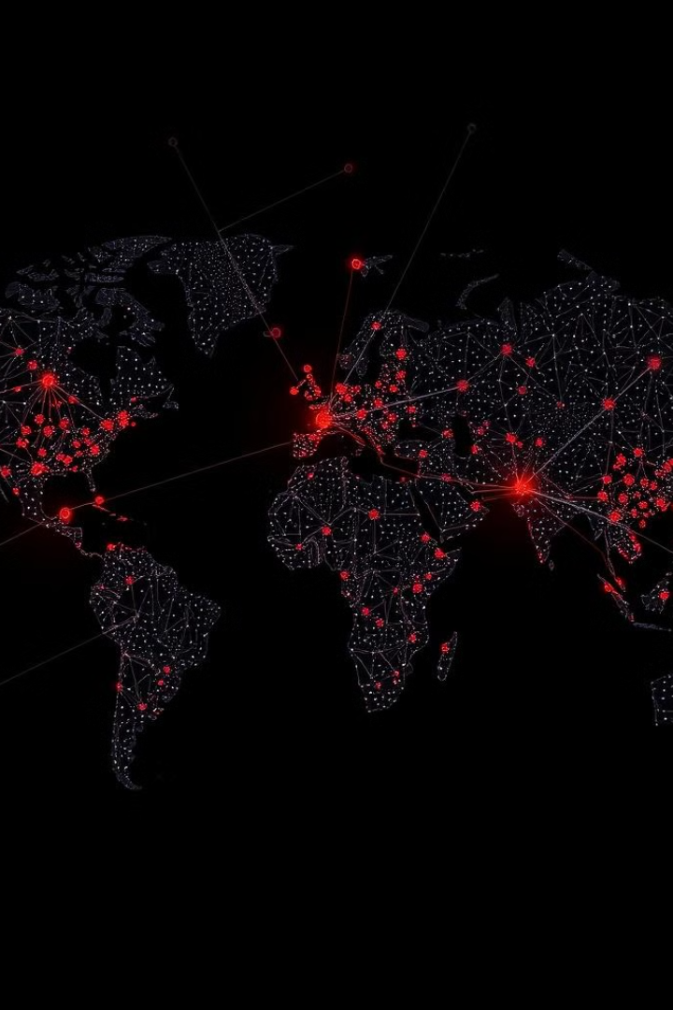



Threat Intelligence Technologies
VirusTotal API integration is included. WHOIS domain validation is performed. GeoIP2 geolocation is tracked. A multi-source threat database is utilized. Suspicious indicators are cross-referenced.
VirusTotal
WHOIS
GeoIP2
Notes:
7

Slide 8
Advanced Detection Heuristics
Pattern recognition algorithms are applied. Anomaly detection techniques are used. Predictive threat modeling is employed. Machine learning powers risk scoring. Adaption occurs from global threats.
Pattern Recognition
Anomaly Detection
Detects known threats.
Finds unusual activity.
Notes:
8

Slide 9

Performance & Scalability
URLs are processed per minute. Detection response time is less than 50ms. Phishing attempts are identified with 85% accuracy. System resource consumption is minimal. Enterprise integration is seamless.
10K+
50ms
85%
URLs/Minute
Response Time
Accuracy
Notes:
9

Slide 10



Future Roadmap
AI will enhance threat prediction. Global threat intelligence will expand. Algorithms will undergo continuous refinement. Machine learning models will be enhanced. A commitment to innovation continues.
1
AI Prediction
2
Global Intel
3
Algorithm Refinement
Notes:
10

